Slide 1
Sermon: Worshiping
Series:
Engaging Church
Revelation 5:8-14 (NASB)

Slide 2
⁸ When He had taken the book, the four living creatures and the twenty-four elders fell down before the Lamb, each one holding a harp and golden bowls full of incense, which are the prayers of the saints.
Revelation 5:8 (NASB)

Slide 3
I. His Sacrifice Rev 5:9
Worshiping

Slide 4
⁹ And they *sang a new song, saying, "Worthy are You to take the book and to break its seals; for You were slain, and purchased for God with Your blood men from every tribe and tongue and people and nation.
Revelation 5:9 (NASB)

Slide 5
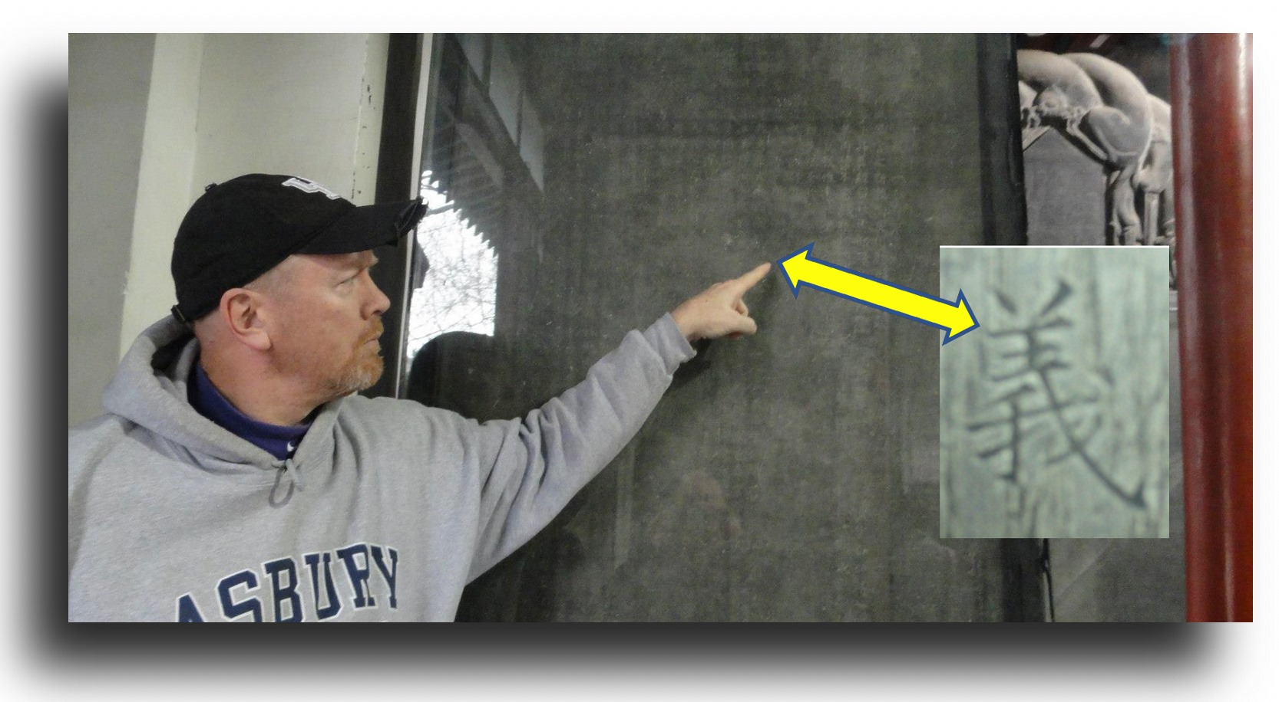
義 Yi
Righteousness
羊 Yang
Lamb
我 Wo
Me

Slide 6
I. His Sacrifice Rev 5:9
II. Our Nature Rev 5:10
Worshiping

Slide 7
¹⁰ "You have made them to be a kingdom and priests to our God; and they will reign upon the earth."
Revelation 5:10 (NASB)

Slide 8
I. His Sacrifice Rev 5:9
II. Our Nature Rev 5:10
III. His Character Rev 5:11-12
Worshiping

Slide 9
¹¹ Then I looked, and I heard the voice of many angels around the throne and the living creatures and the elders; and the number of them was myriads of myriads, and thousands of thousands,
Revelation 5:11 (NASB)

Slide 10
¹² saying with a loud voice, "Worthy is the Lamb that was slain to receive power and riches and wisdom and might and honor and glory and blessing."
Revelation 5:12 (NASB)

Slide 11
I. His Sacrifice Rev 5:9
II. Our Nature Rev 5:10
III. His Character Rev 5:11-12
IV. His Creation Rev 5:13
Worshiping

Slide 12
¹³ And every created thing which is in heaven and on the earth and under the earth and on the sea, and all things in them, I heard saying, "To Him who sits on the throne, and to the Lamb, be blessing and honor and glory and dominion forever and ever."
Revelation 5:13 (NASB)

Slide 13
¹⁴ And the four living creatures kept saying, "Amen." And the elders fell down and worshiped.
Revelation 5:14 (NASB)

Slide 14
Worshiping
All In

Slide 15
Questions: 1. What was the best choir or musical group you have ever heard (or participated in)? What was memorable about the group? 2. What sticks out to you about the worship scene here in Revelation 5? 3. What is your great challenge in your own private worship? In corporate worship in small group? In Corporate worship at church? 4. What do you like about worship in church?

Slide 16
Questions: 5. What do you need to add into your life to enhance and engage with worship more? 6. God is the focus of worship in Revelation chapter 4. Jesus is the focus of worship in Revelation chapter 5. But in Revelation 5:13 John states that both God sitting on the throne and Jesus are worshiped. Who do you tend to think of when you worship? Why do you think that having both the Father and Jesus as the center of worship is key? What role does the Holy Spirit have in our worship? (see John 4:23-24; Revelation 4:5).

Slide 17
Questions: 7. What would the vision of Revelation 5 do to the persecuted Christians mentioned in Revelation chapters 1-3 during the reign of Domitian around 90 A.D.? 8. What does the vision of Revelation 5 have to say to us as we view our out-of-control world?

Slide 18
Questions: 9. What does the following verses add to the concept of our worship and what it should look like? 1 Corinthians 10:31 (NASB) 31 Whether, then, you eat or drink or whatever you do, do all to the glory of God. Romans 12:1-2 (NASB) 1 Therefore I urge you, brethren, by the mercies of God, to present your bodies a living and holy sacrifice, acceptable to God, which is your spiritual service of worship. 2 And do not be conformed to this world, but be transformed by the renewing of your mind, so that you may prove what the will of God is, that which is good and acceptable and perfect.

