Slide 3
The True Temple
John 2:13-25 ESV

Slide 4
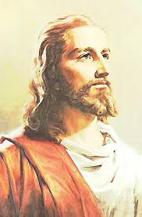
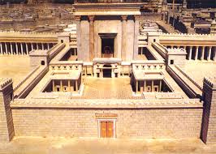
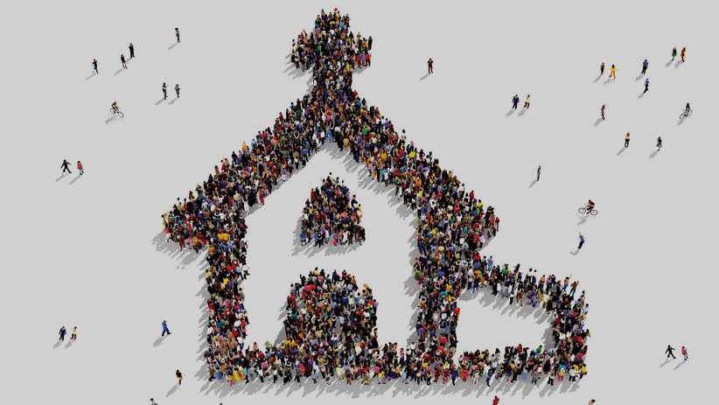
The True Temple
Temporary Temple (v 13-17)
Eternal Temple (v 18-22)
We are His Temple (v 23-25)
II.
I.
III.

Slide 5
John 2:13 ESV
The Passover of the Jews was at hand,and Jesus went up to Jerusalem.

Slide 6
John 2:14 ESV
In the temple he found those who were selling oxen and sheep and pigeons, and the money-changers sitting there.

Slide 7
John 2:15 ESV
And making a whip of cords, he drove them all out of the temple, with the sheep and oxen.
And he poured out the coins of the money-changers and overturned their tables.

Slide 8
John 2:16 ESV
And he told those who sold the pigeons, “Take these things away; do not make my Father's house a house of trade.”

Slide 9
John 2:17 ESV
His disciples remembered that it was written, “Zeal for your house will consume me.”

Slide 10
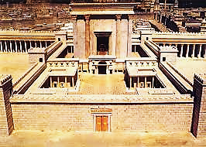
I. Temporary Temple (v 13-17)
1. Jesus Visits the Temple (v 13)
2. Jesus Cleans House (v 14-17)

Slide 11
John 2:18 ESV
So the Jews said to him, “What sign do you show us for doing these things?”

Slide 12
John 2:19 ESV
Jesus answered them, “Destroy this temple, and in three days I will raise it up.”

Slide 13
John 2:20 ESV
The Jews then said, “It has taken forty-six years to build this temple,^{[c]} and will you raise it up in three days?”

Slide 14
John 2:21 ESV
But he was speaking about the temple of his body.

Slide 15
John 2:22 ESV
When therefore he was raised from the dead, his disciples remembered that he had said this, and they believed the Scripture and the word that Jesus had spoken.

Slide 16
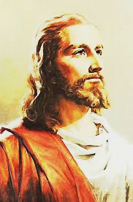
II. Eternal Temple (v 18-22)
1. Brick building vs. Jesus
2. Temple of His body (v 18-21)
3. Faith in the Resurrection (v 22)

Slide 17
John 2:23 ESV
Now when he was in Jerusalem at the Passover Feast, many believed in his name when they saw the signs that he was doing.

Slide 18
John 2:24 ESV
But Jesus on his part did not entrust himself to them, because he knew all people.

Slide 19
John 2:25 ESV
and needed no one to bear witness about man, for he himself knew what was in man.

Slide 20
III. We Are His Temple (v 23-25)
1. Do we believe in signs or Christ? (v 23)
2. Jesus knows our heart (v 24-25)
3. Jesus dwells in us & among us

Slide 21
SMALL GROUP QUESTIONS:
What was different when Jesus visited the Temple this time vs other times?
What kind of good & healthy zeal can we have for God?
Why would God choose to dwell in a temple until the coming Messiah?
How did you feel when someone told you, “I’m always here for you, I’ll always be around.”? Can you please share?
Now how do you feel, knowing God always wants to be with you?
Why and how is the Spirit made available to us?
What are the “tables” (sins, struggles, hopelessness, etc.) in your life that God has been turning over?
How are you experiencing God calling you into a deeper relationship & reliance with Him?
How is the resurrection significant in John 2:13-25?
Have you ever cared more for the church, or church building, more than Christ? How did God help you get back on track to put Jesus first?
How is it life changing for you, knowing that God can live anywhere and He chose in us & among us through Jesus.

Slide 22
The True Temple
John 2:13-25 ESV

